Slide 1

My Process To Solve Problems
Wladymir Brborich

Slide 2

Quick Disclaimer
This is my own methodology, it may or may not help you, take all I say with a grain of salt

Slide 3

Think what you want to accomplish
Don’t lose focus on the main goal
Choose which features are the most important
Know your limitations and abilities
Don’t waste your time
Negotiate
Ask for guidance not for solutions
This is not an excuse to make garbage code

Slide 4


Think in terms of processes
Look at your code as a factory, you give inputs to get some results
Try to solve the problem in a procedural way
Mock up, draw.
Order your thought process

Slide 5


Master Data Structures
Everything in programing is about data, learn how to store it, loop through it, access it, optimize it …
Nail down the use cases.
Quickly evaluate pros and cons of certain Data Structures for the problem you are trying to solve
Practice!!

Slide 6
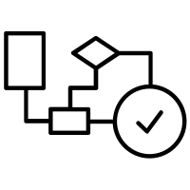
Know your algorithms
Algorithms are the TOOL while programing, let them be your friends.
Learn the basic ones: Sorting, Searching, Comparing (Pattern-Matching) …
Know each algorithm’s use cases, not necessarily how to code it, but how it works and when can you get some benefit from it.
Simple is better, don’t be arrogant

Slide 7

A Final Word
To get really good at programming you need to commit
It takes time, effort and lots of practice
It will help you to solve other kinds of problems in your personal affairs
Keep it simple, Keep it clean

